Slide 1

Can You Feel the Beat?
Measuring the quantum beat
Shivam Suthendran (20499543)

Slide 2
Summary of Contents
PREMISE AND MOTIVATION | Building blocks | Block assembly and analysis | results
Indistinguishability | The Photon | Second-Order Correlation Function - Detecting the Quantum Beat | Conclusions
Plan of Attack | Hong-Ou-Mandel Experiment | Probability Distribution - Interpreting the Probability Distribution | Future Considerations
 | Second Order Correlation Function |  | Acknowledgements

Slide 3
The Question of Indistinguishability
Can you tell me about the final particle trajectories?
What if they were quantum particles?

Slide 4
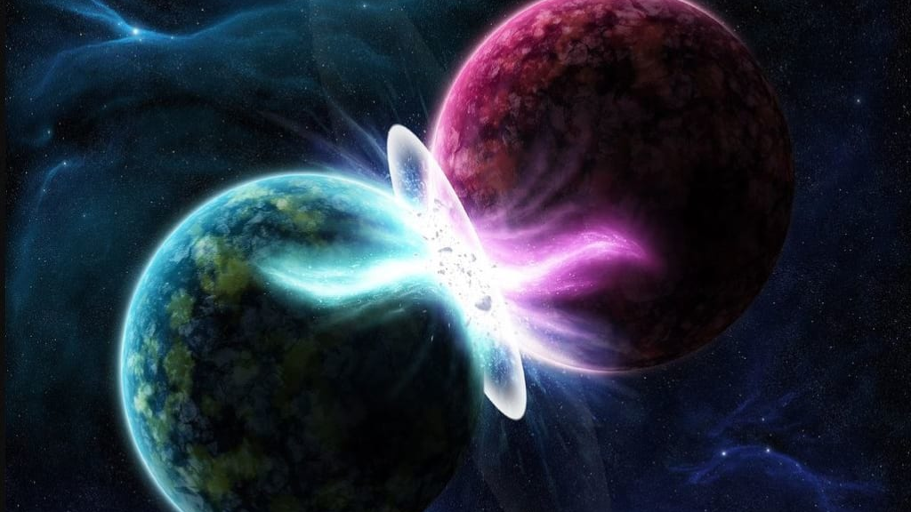
Photon Indistinguishabilty
Quantum Computing requires the generation of indistinguishable entangled photon pairs
How does one determine photon distinguishability?
https://miro.medium.com/max/1024/1*twIJrqreLpie6__bnqE9rg.png

Slide 5

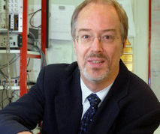
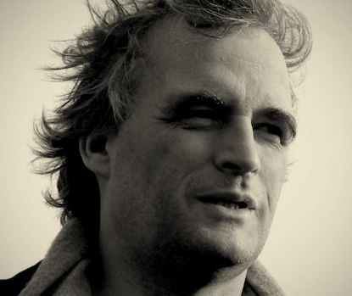

Plan of Attack
Motivated by “Time- Resolved Two-Photon Interference” by Legero, Wilk, Kuhn, and Rempe:
Demonstrate Quantum Beat
Compare Probability Distribution Found with Idealized HOM Probability Distribution

Slide 6
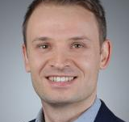


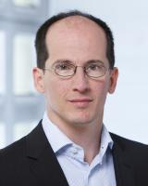

Plan of Attack - 2
Process Outlined in “Signatures of Hong-Ou-Mandel Interference at Microwave Frequencies
Perform Hung-0u-Mandel Experiment on Incident Photons
Determine Associated Second Order Correlation Function
Integrate Second-order Correlation Function Over all Possible Detection Times

Slide 7
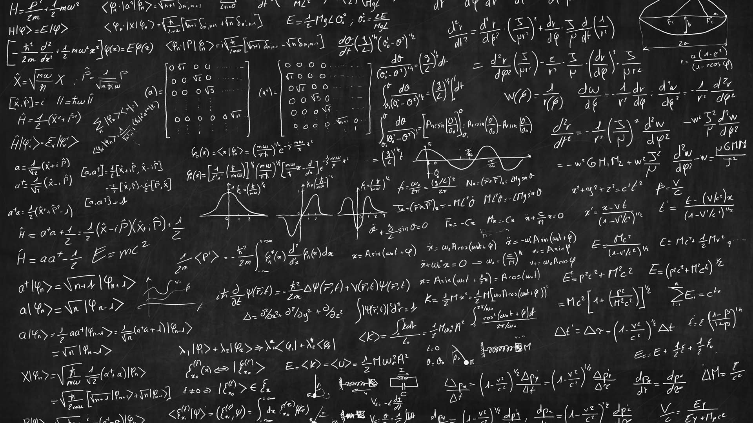
Plan of Attack - 3
Shape of the Photon
Hung-Ou-Mandel Experiment
Second Order Correlation Function
https://www.gettyimages.ca/

Slide 8
The Photon

